Slide 1






SMART INDIA HACKATHON 2026
Problem Statement ID – SIH26140
Problem Statement Title-AI-Based Interactive Quantum Algorithm Learning Platform
Theme-Smart Education
PS Category- Software
Team ID-
Team Name – Cognitive Crew
TITLE PAGE

Slide 2
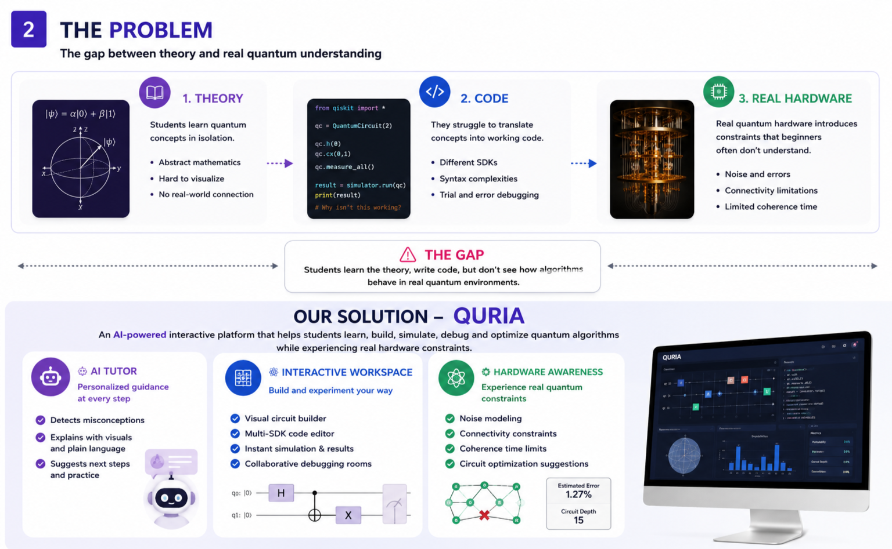
Cognitive crew
QURIO — AI-Powered Interactive Quantum Algorithm Learning Platform
Learn quantum algorithms. Build circuits. Understand real hardware.
SIH 2026 Idea Submission — Quria
2
2

Slide 3
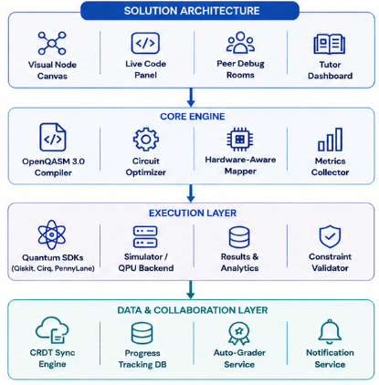
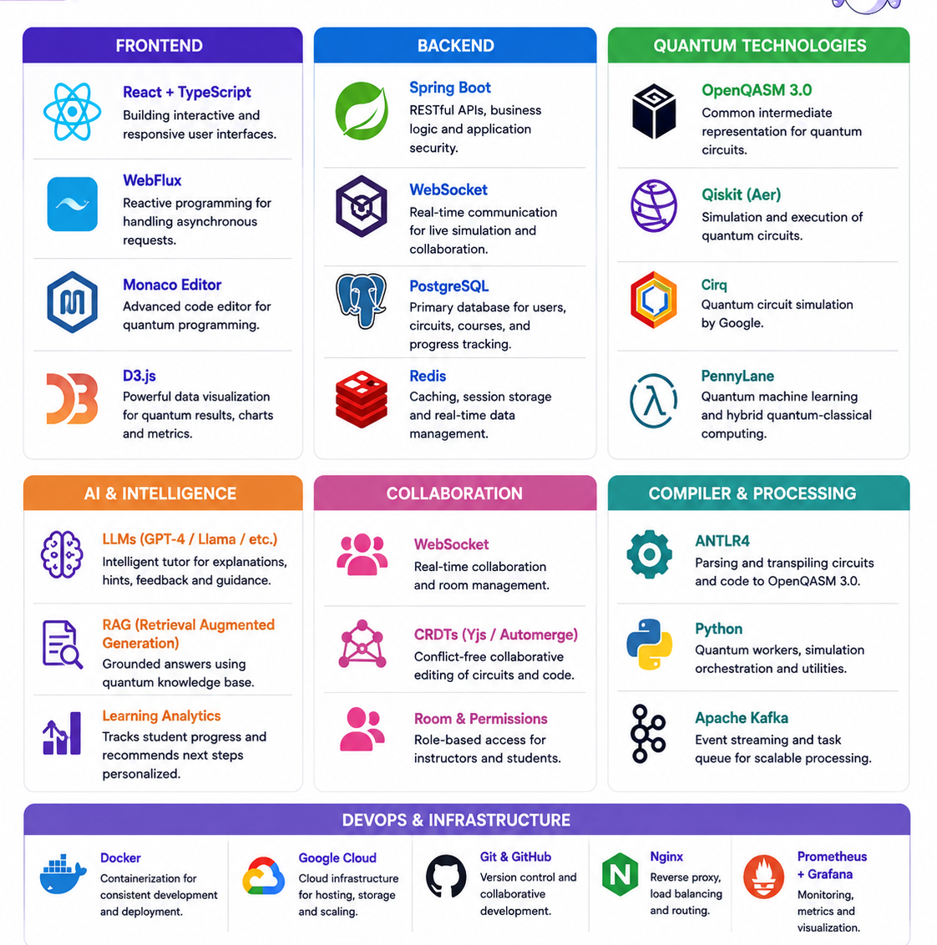
Cognitive crew
TECHNICAL APPROACH
Technologies Used:
Methodology / Implementation Flow
Monaco multi-SDK script / visual canvas sends circuit input to the Spring Boot Gateway.
Gateway streams the request through Kafka to the Python worker cluster.
ANTLR4 transpiles visual/code input into a unified OpenQASM 3.0 pipeline.
Multi-backend runner executes the matching SDK loop (Aer / Cirq / PennyLane).
D3.js layer renders Bloch spheres, probability charts and circuit metrics.
SIH 2026 Idea Submission — Quria
3
3

Slide 4
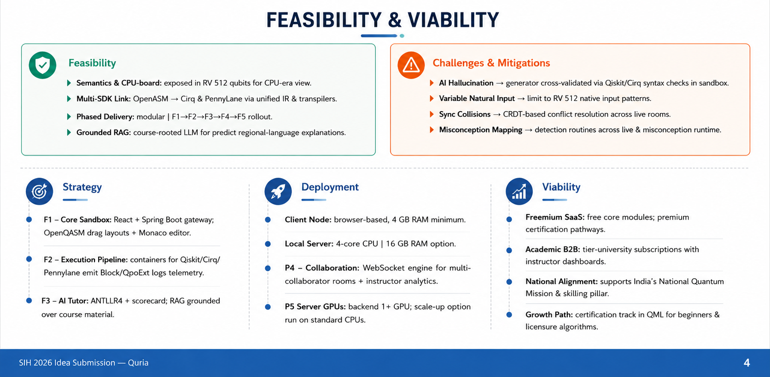
Cognitive crew
4
4

Slide 5
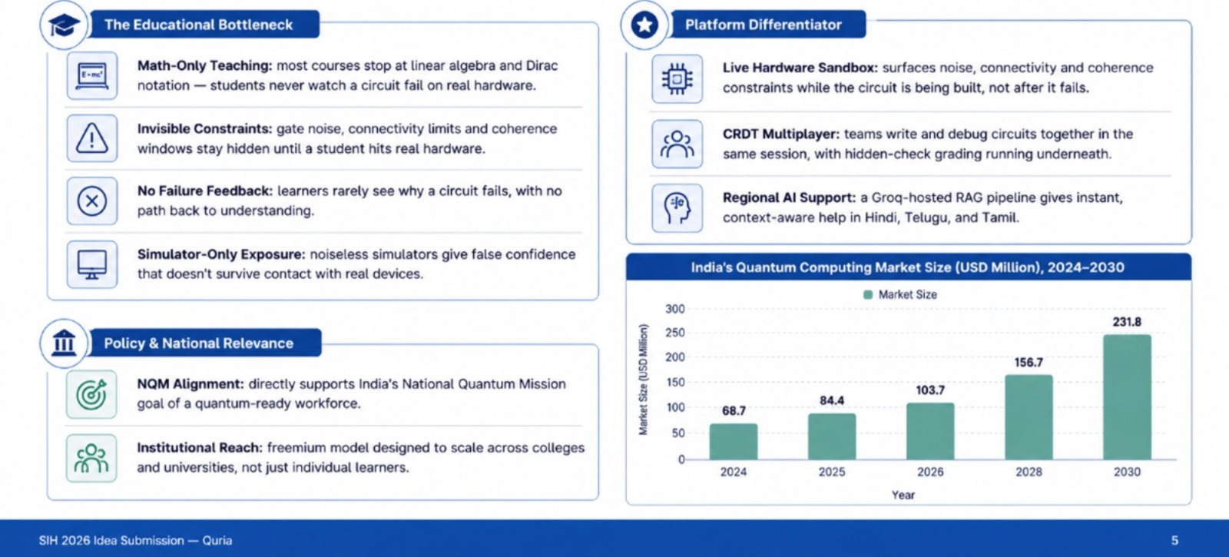
Cognitive crew
IMPACT AND BENEFITS
5
5

Slide 6
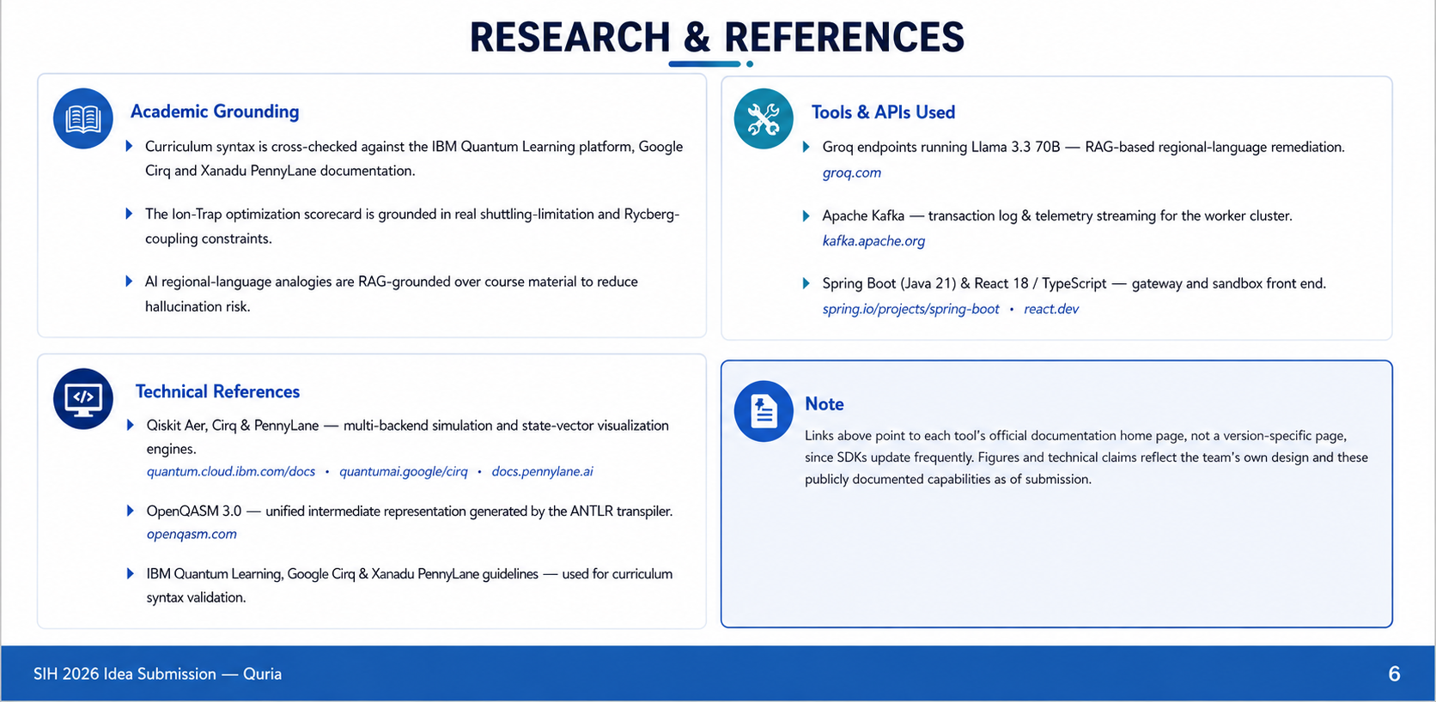
Cognitive crew
6
6

